Slide 1

Expectation maximization
Sajad Sarlaki
Aref Motamedi
Ehsan Nazerfard
Hossein Beheshti
June 2021

Slide 2
Table of Contents
Statistics And Probability
EM
01
03
Maximum Likelihood
EM Usages
02
04
Statistics and Data Distribution
What is EM?
Example
Definition
- Image compression
Estimation With Supervised Data
- More examples
Estimation With Unsupervised Data

Slide 3

01
Statistics And Probability
- Importance of Statistics in Data science
- Distributions

Slide 4

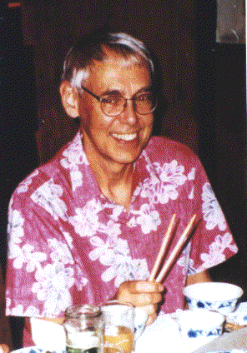
“It’s easy to lie with statistics. It’s hard to tell the truth without statistics.”
—Andrejs Dunkels

Slide 5
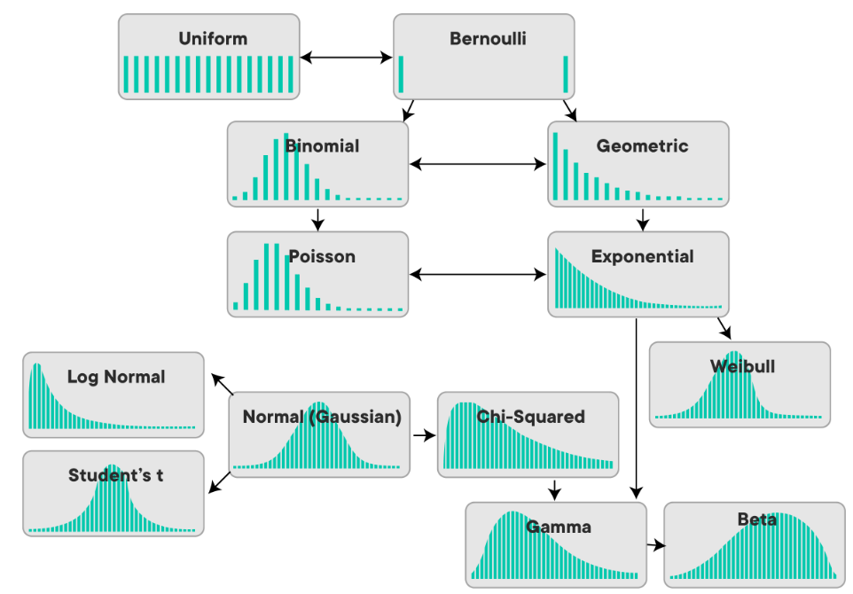
Distributions
A data distribution is a function or a listing which shows all the possible values (or intervals) of the data. It also (and this is important) tells you how often each value occurs.

Slide 6
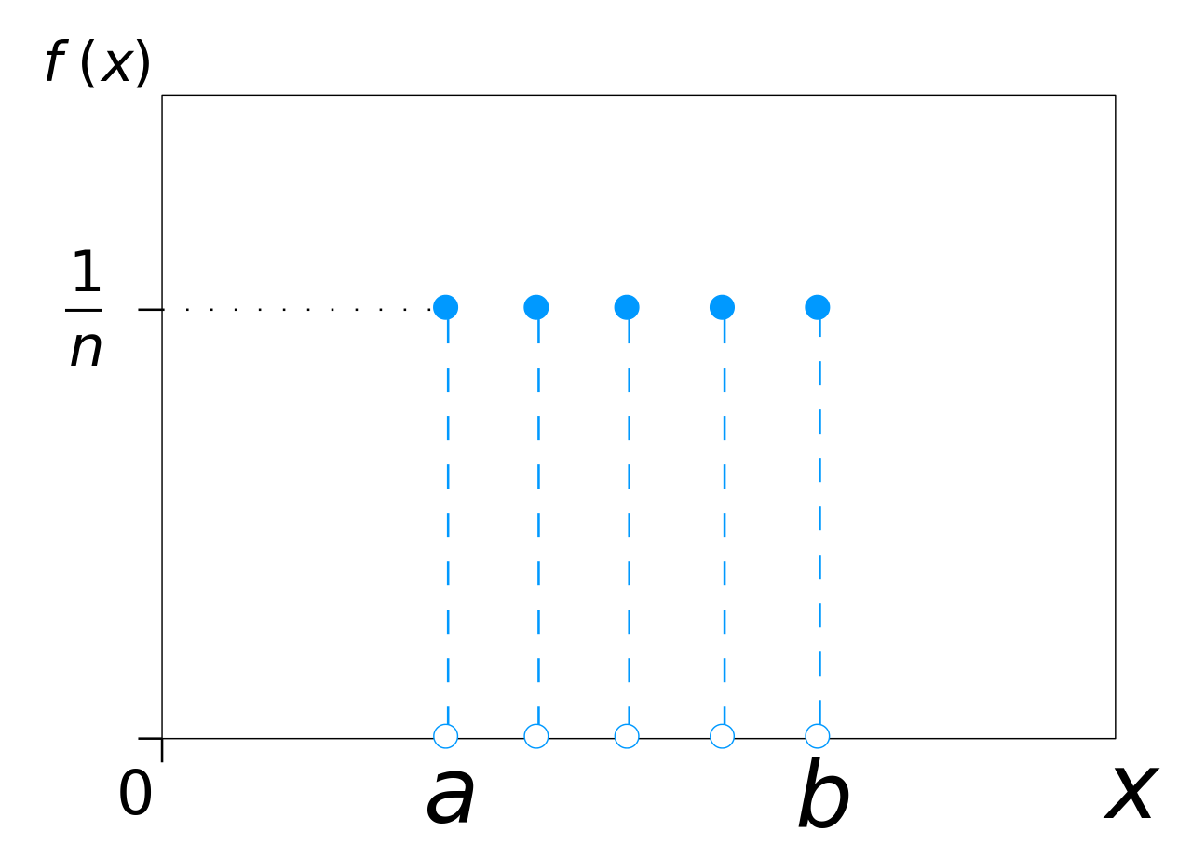
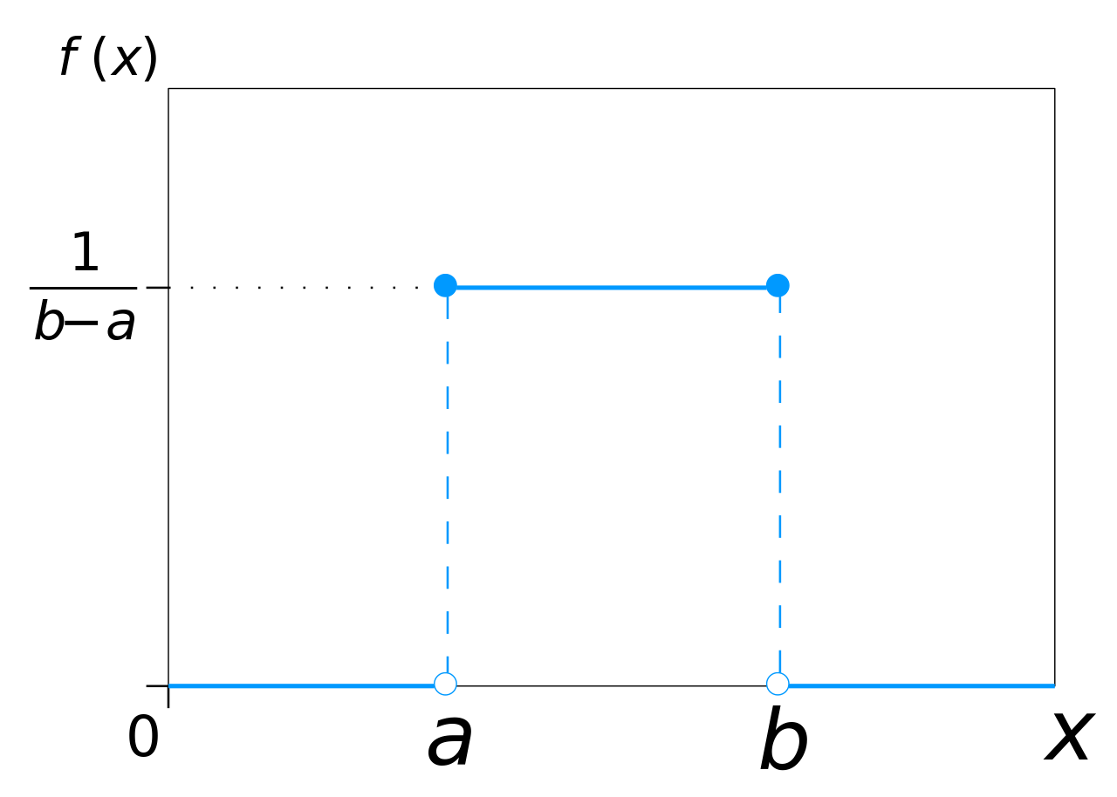


Uniform distribution
Discrete Uniform Distribution
$$f_{X}(x)=P(X=x)=\frac{1}{n},x∈S$$
There are tow types of uniform distribution
Continuous Uniform Distribution
$$f_{X}\left(x\right)=\frac{1}{b−a},a≤x≤b$$

Slide 7
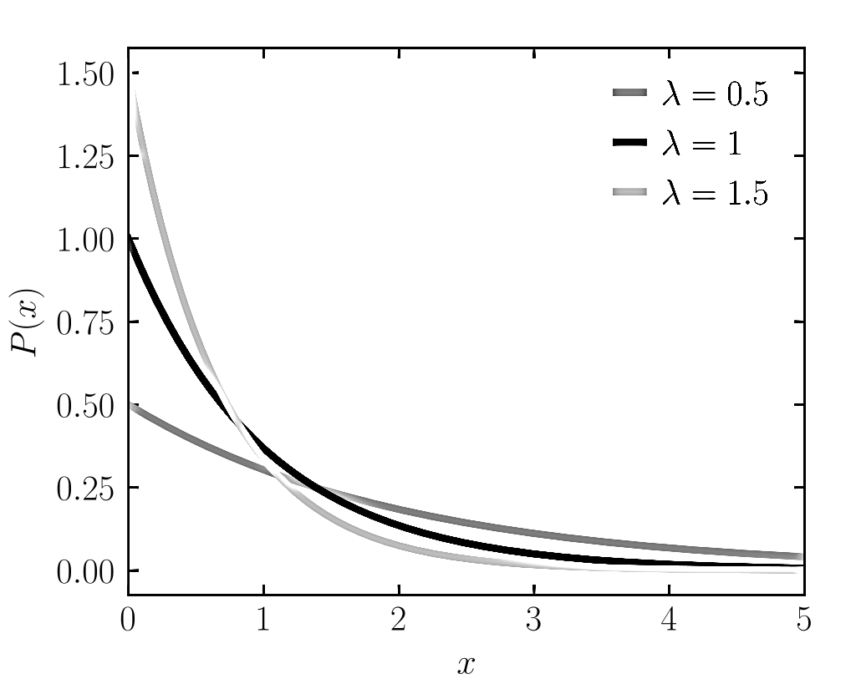

Exponential Distribution
$$f\left(x;λ\right)=\left\{\begin{aligned}λe^{−λx} x≥0 \\ 0 x<0 \end{aligned}\right.$$

Slide 8
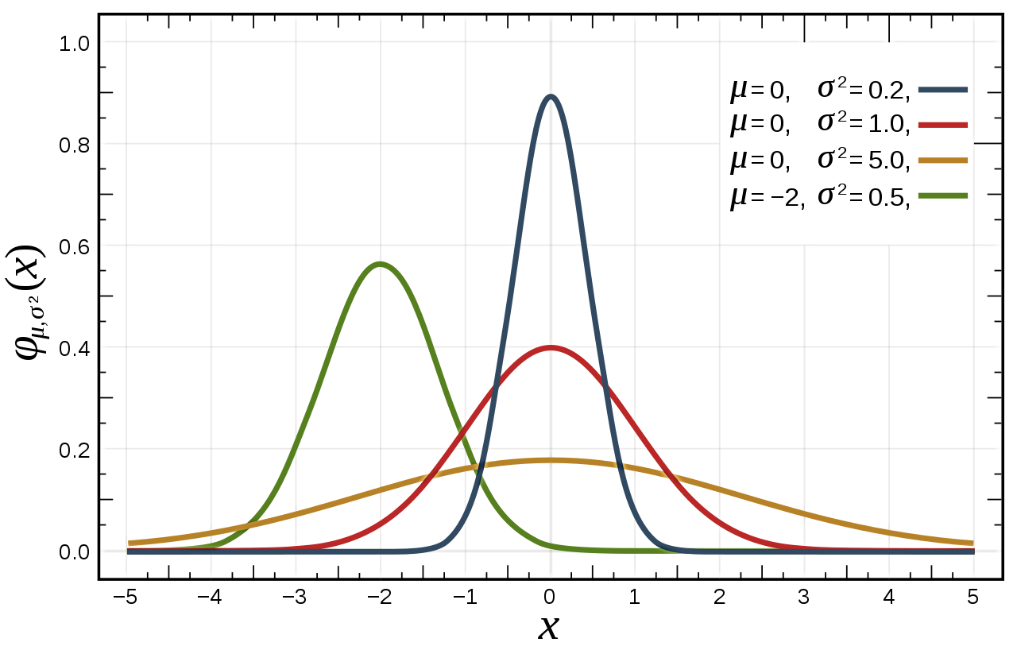

Normal Distributions
$$Ν(μ, σ^{2})$$
$f\left(x\right)=\frac{1}{σ\sqrt{2π}}e^{−\frac{1}{2}{\left(\frac{x−μ}{σ}\right)}^{2}}$
$σ=$ standard deviation
$μ=$ mean

Slide 9
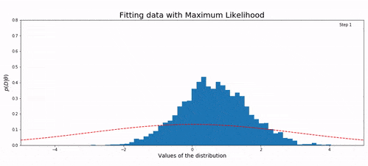
02
Maximum Likelihood
- Definition
- Supervised
- Unsupervised

Slide 10
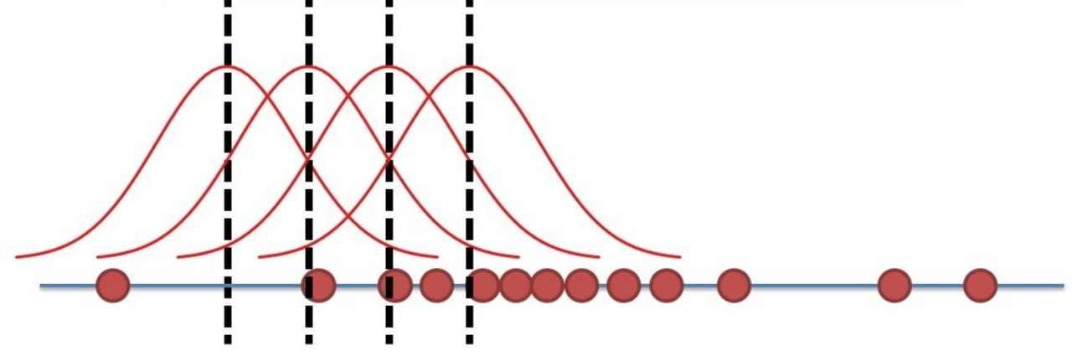
Definition
maximum likelihood estimation (MLE) is a method of estimating the parameters of a probability distribution by maximizing a likelihood function, so that under the assumed statistical model the observed data is most probable.

Slide 11
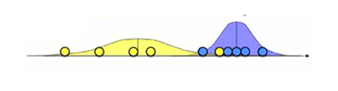

MLE for
supervised learning
- Observation
- Data are labeled.
- Just needs to calculate mean
and variance for each cluster

Slide 12
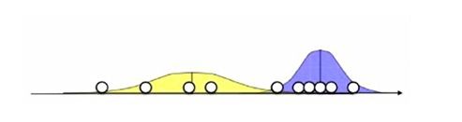
Lets think backward
- Observation
- Data are NOT labeled.
- We have mean and variance for
each cluster

Slide 13
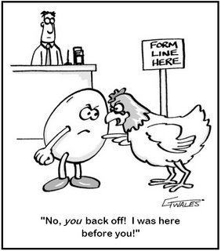
MLE for
unsupervised learning
- Data are NOT labeled.
- No mean and variance is known
- its a CHICKEN AND EGG problem!

Slide 14

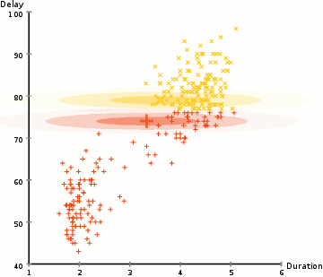
03
EM
- Definition
- Why EM?
- How does it work?
- Pros and Cons

Slide 15
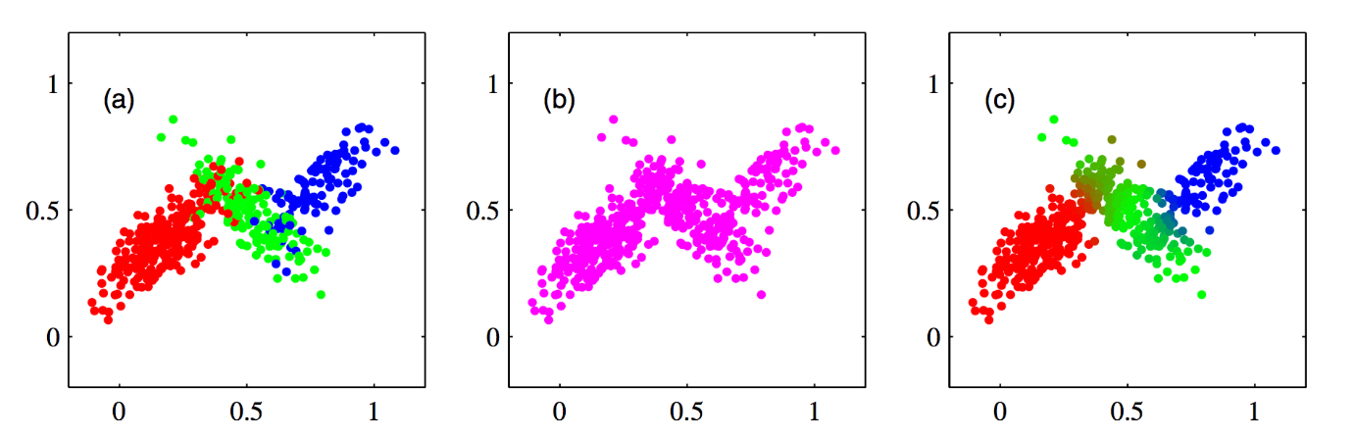
Definition of EM
expectation–maximization(EM) algorithm is an iterative method to find (local) maximum likelihood or maximum a posteriori (MAP) estimates of parameters in statistical models, where the model depends on unobserved latent variables Or includes missing values.
Soft clustering VS
Hard clustering
Goal
- Maximizing MLE or MAP
- finding distributions or clusters

Slide 16

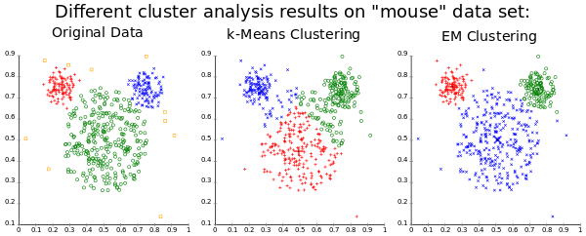
Why EM?
EM VS K-means
- What if clusters are overlapping?
- K-means use Euclidian distance
- What if cluster has a non-circular shape?

Slide 17
How does it works?
START
INITIALIZATION
E-STEP
M-STEP
NO
CONVERGENCE
YES
STOP

Slide 18
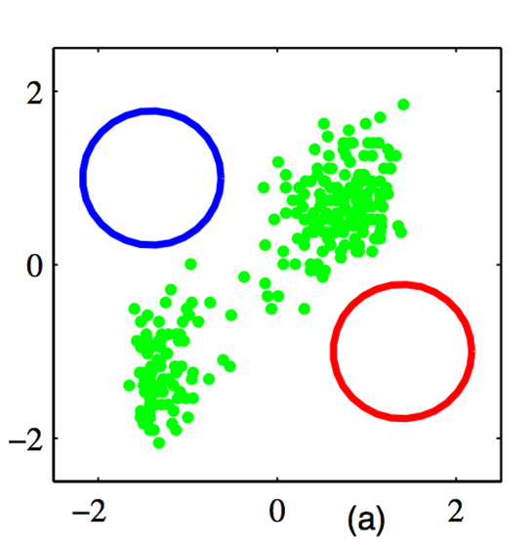

How does it works?
Initialization:
Initialize the means $μ_{k},$covariances $\sum_{k}{ }$
and mixing coefficients $π_{k}$
And evaluate the initial value of log likelihood
- Mostly use k-mean

Slide 19
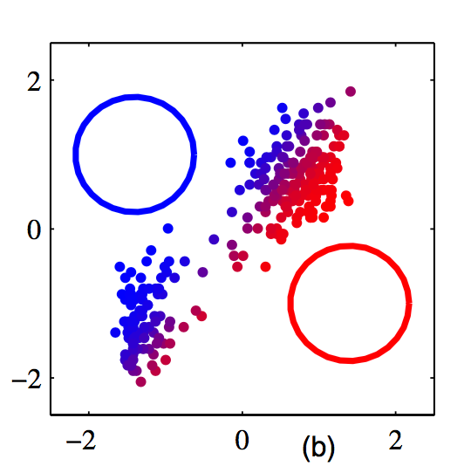
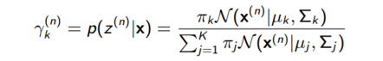

How does it works?
E-step:
For each cluster k and data n, evaluate the responsibilities given current parameters:
Mean $μ_{k},$
Covariances $\sum_{k}{, }$
mixing coefficients $π_{k}$

Slide 20
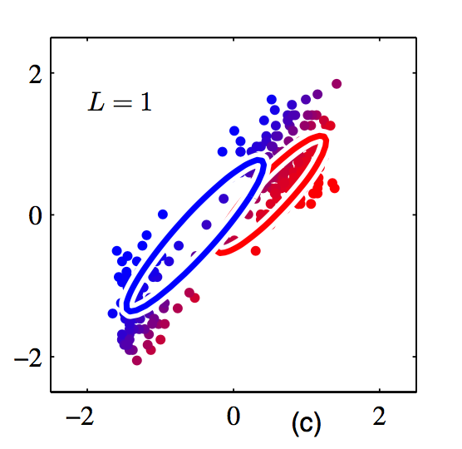
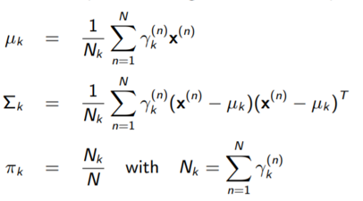

How does it works?
M-step:
Starts with assignment probabilities $r_{nk}$
Update parameters:
Mean $μ_{k},$
Covariances $\sum_{k}{, }$
mixing coefficients $π_{k}$

Slide 21
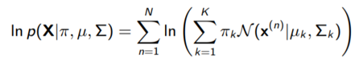
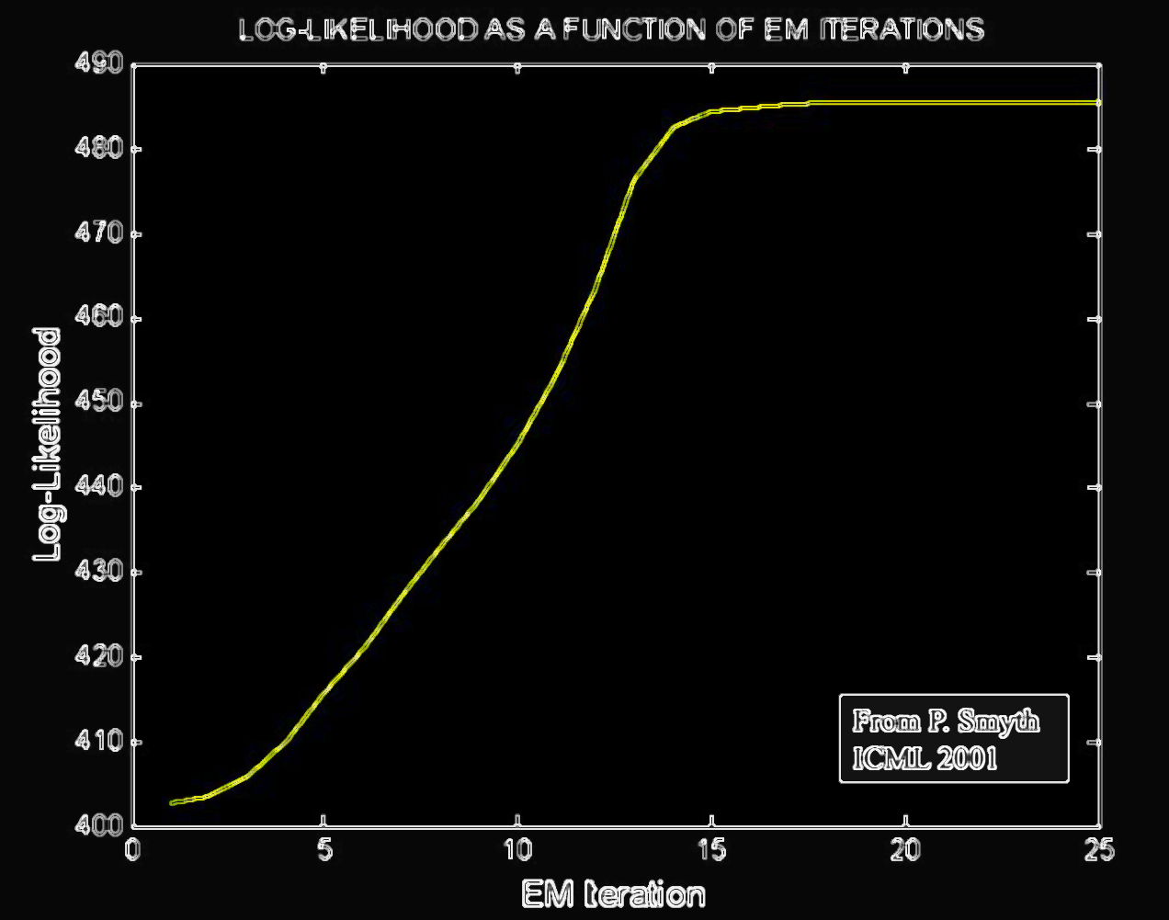
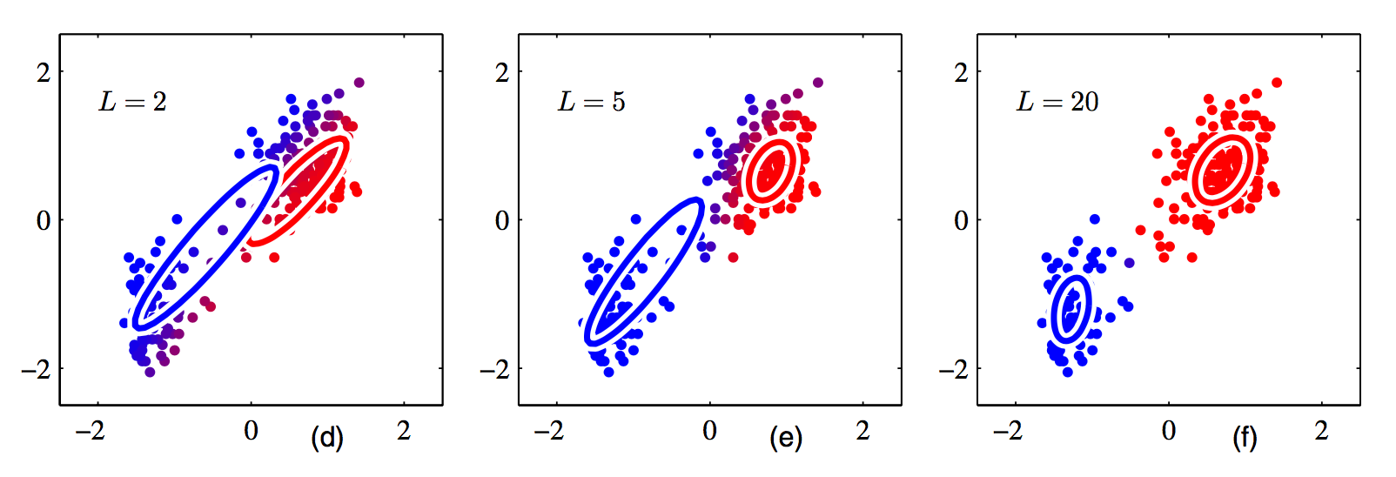
How does it works?
Evaluation:
Evaluate log likelihood and check for convergence:
Repeat E-step and M-step until convergence:

Slide 22
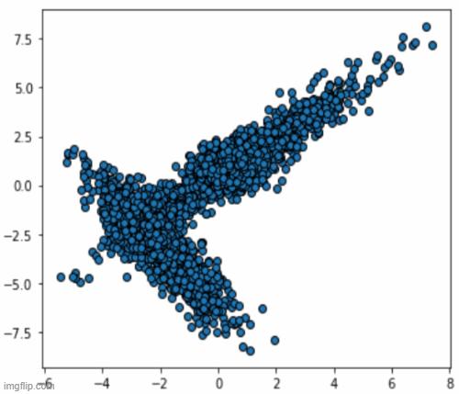
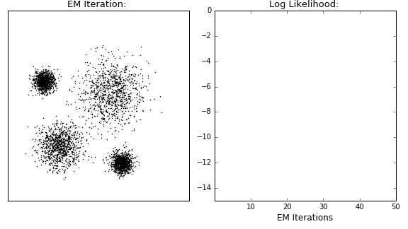
Another example
- Initialization
- until converagence :
E-step
M-step

Slide 23
Pros
Cons
- Works well in practice
- It is guaranteed that the likelihood
will increase in each iteration.
- Not guaranteed to give MLE
(may stuck in local minimum)
- Has very slow convergence
- Requires both forward and
backward probabilities

Slide 24
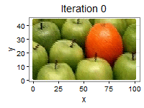
04
EM Usages
- Image compression
- unsupervised clustering algorithm
- NLP applications like Latent Dirichlet Allocation

Slide 25
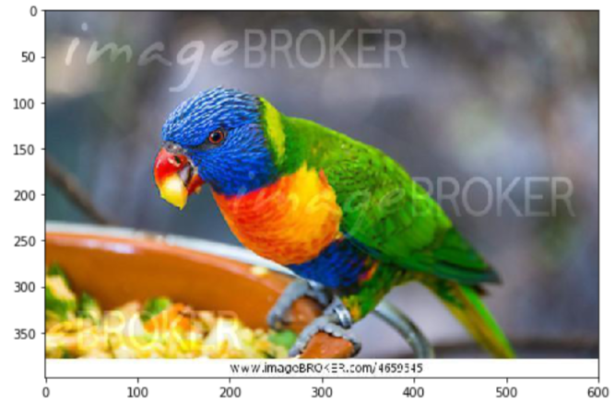
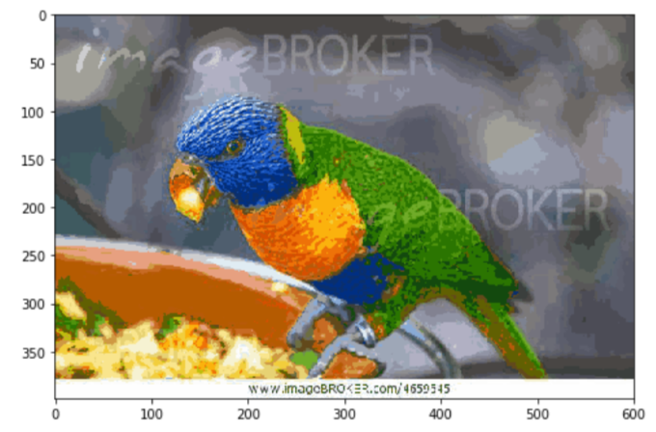

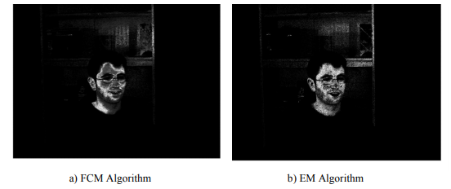


Image compression
$$⟹$$
Example:
Difference between FCM and EM:
$$⟹$$

Slide 26
References
CSC 411: Lecture 13: Mixtures of Gaussians and EM, Richard Zemel, Raquel Urtasun and Sanja Fidler Ravanbakhsh, E., Rezaei, M., Namjoo, E. and Choobdar.
Comparison between EM and FCM algorithms in skin tone extraction. Hu, Y., Wai, L. and Chee, S., 2012, November.
Clustering algorithms for scene classification—A performance comparison between
K-means; fuzzyc-means and GMM. In Proc. IIEEJ Image Electron. Vis. Comput. Workshop (pp. 1-6).
https://en.wikipedia.org/wiki/Expectation%E2%80%93maximization_algorithm#:~:text=One%20of%20the%20earliest%20is,L%C3%B6f%20and%20Anders%20Martin%2DL%C3%B6f.
https://towardsdatascience.com/expectation-maximization-explained-c82f5ed438e5
https://medium.com/analytics-vidhya/expectation-maximization-algorithm-step-by-step-30157192de9f
https://github.com/volflow/Expectation-Maximization
https://www.youtube.com/watch?v=qMTuMa86NzU

Slide 27

Thanks!
Do you have any questions?

